Slide 1
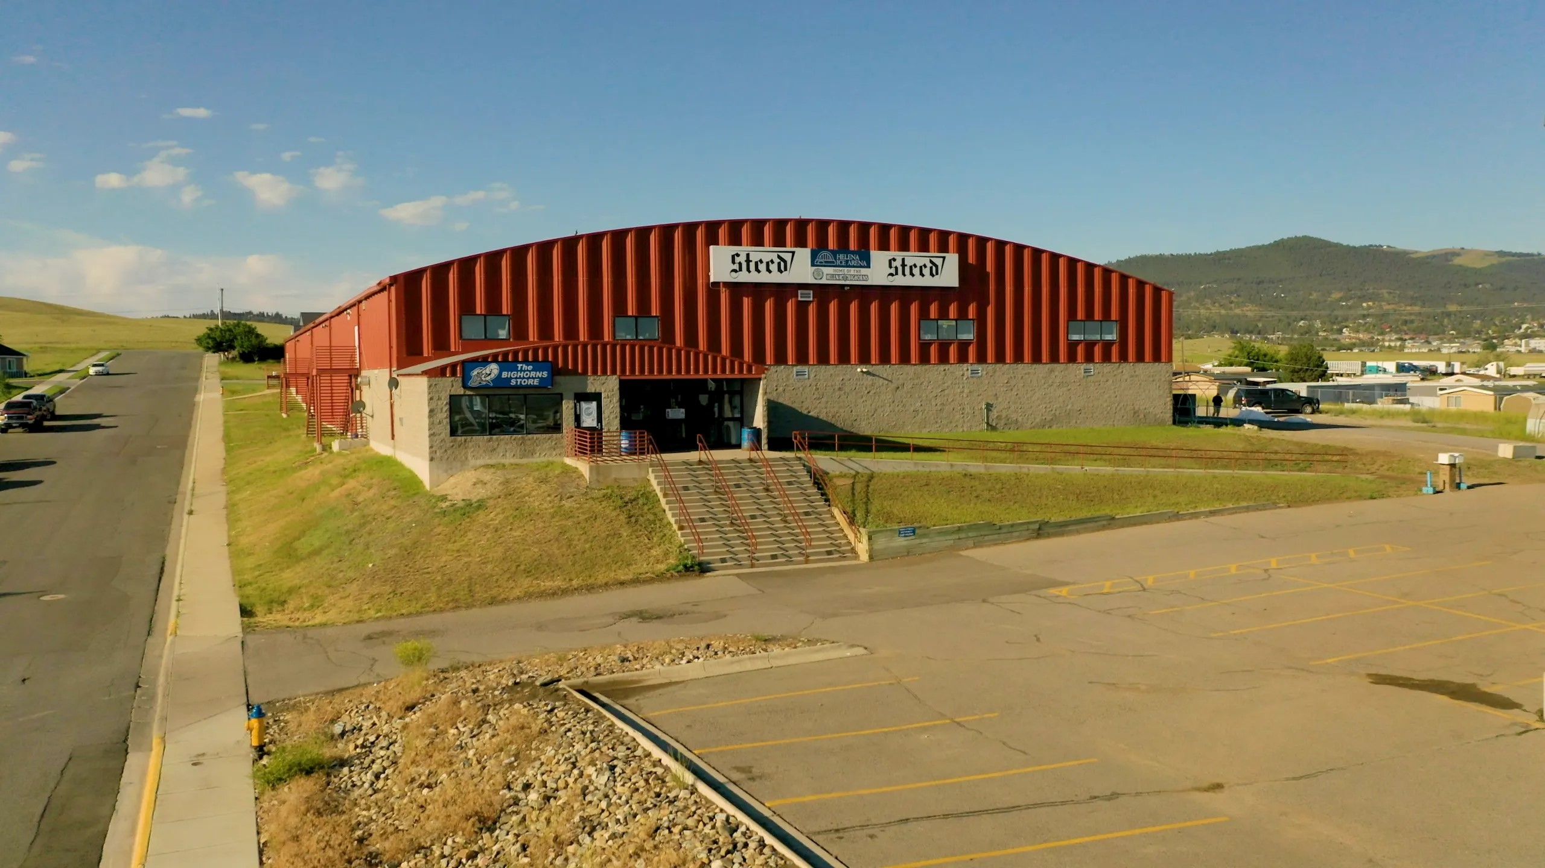
Steed Arena
Systems Analysis & Design
By: Clayton, Oliver, and Kayla
Notes:
(Clay) disclaimer!

Slide 2

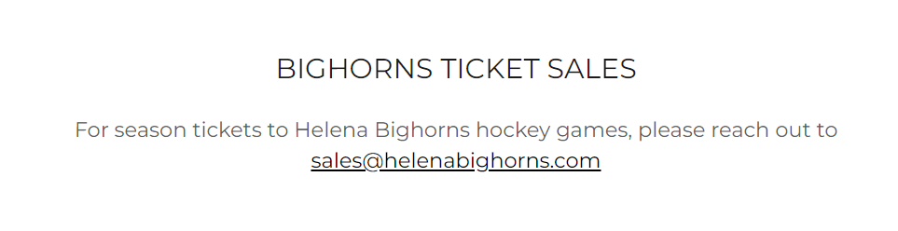
Executive Summary
Initially planned to use new software for ticketing
Shifted Focus to fix issues at Steed Arena
Want to save on energy costs
Main challenge isn't ticket sales but making operations better.
Our team will suggest solutions for cooling and energy issues.
Goal is to make Steed Arena more sustainable and financially strong.
Notes:
(kayla) thank you all for being here today and your time Our initiative to improve Steed Arena's ticketing system began with the aim of enhancing user experience and operational efficiency. Originally planning to implement a Software as a Service solution, we discovered that ticket sales for the Helena Bighorns are managed through Vivenu on the team's website, not Steedarena.com. This realization shifted our focus from ticketing to addressing more pressing concerns at Steed Arena, particularly issues with the cooling system and the need for energy cost optimization. Interestingly, the arena's primary challenge is not ticket sales but energy operational issues.
Given its unique position as the sole hockey rink in the area and as a for-profit entity, Steed Arena faces difficulties securing grants from Northwestern Energy and with a program called CPase. In response, our team is prepared to present alternatives that address these specific challenges, aiming to improve the arena's sustainability and financial resilience.

Slide 3
Ticketing system

Slide 4
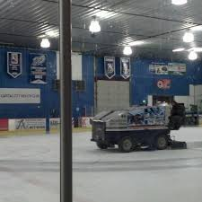
System Concerns
Email-based transactions may result in delays and require significant manual effort.
Lack of a centralized database makes tracking and managing ticket sales cumbersome.
Real-time reporting for managers is hindered by reliance on manual processes.
Vendor lease renewal involves time-consuming email exchanges.
Notes:
(clay)
Email-based transactions can result in delays and require significant manual effort:
This iImpacts the overall efficiency of the ticketing process.
Manual effort is needed to manage and process each email inquiry, potentially resulting in delays in response to customers.
The lack of a centralized database makes managing and tracking ticket sales inconvenient:
Creates a challenge to manage customer details, event information, and financial transactions.
Manually tracking email exchanges can result in data inconsistency and problems retrieving information in real time.
Manual processing causes delays in information reporting:
Lack of automated system impedes the ability to provide timely and accurate insights into ticket sales, attendance, and revenue.
Vendor lease renewal is hindered by time-consuming email exchanges:
Email exchanges are prone to errors and time-consuming, potentially affecting vendor relationships.

Slide 5

System Requirements
Web-based Platform
Mobile Compatibility
Security Measures
User-Friendly Interface
Notes:
Need to be a Web-based Platform: The enhanced ticketing system should be accessible through a web browser to ensure ease of use for patrons.
Mobile Compatibility: The platform should be mobile-friendly to accommodate users who prefer to purchase tickets using their smartphones.
Security Measures: Must implement robust security measures to protect sensitive customer information and financial transactions, ensuring a secure online ticket purchasing experience.
User-Friendly Interface: Ensure an intuitive interface for ease of use, facilitating efficient financial tracking and reporting.

Slide 6

Ticketing Systems
Brushfire — SaaS
OSEM — Self-hosted
Eventbrite — SaaS
Notes:
Brushfire: Brushfire offers a user-friendly, all-in-one event management solution with flexible pricing, robust virtual event capabilities, and dedicated customer support. It caters to events of various sizes, providing tools for ticketing, registration, and enhancing overall attendee experience.
Open Source Event Manager: OSEM. This is an open-source event management solution designed specifically for free software conferences. Its features cover paper submission, marketing, analytics, and comprehensive event administration. The platform is used by notable events like LinuxFest Northwest, emphasizing its reliability and effectiveness in managing free software conferences.
Eventbrite: Eventbrite offers flexible ticketing options. Organizers can create different types of tickets (e.g., general admission, VIP, early bird) with varying prices and quantities. You can also set up promotional codes and discounts to incentivize ticket purchases.

Slide 7
System Users
Notes:
Jed was the only actual person we spoke with. The other system users we mention are real people but there accounts are fabricated.

Slide 8

The Helena Bighorns
"With improved conditions, we believe our performance could be enhanced. The community's support through a better facility means a lot to us."
Notes:
(Clay) The Bighorns would expressed their appreciation for the facility while acknowledging a limited understanding of the operational costs and environmental aspects of running an ice rink. They emphasized the significance of community support.

Slide 9
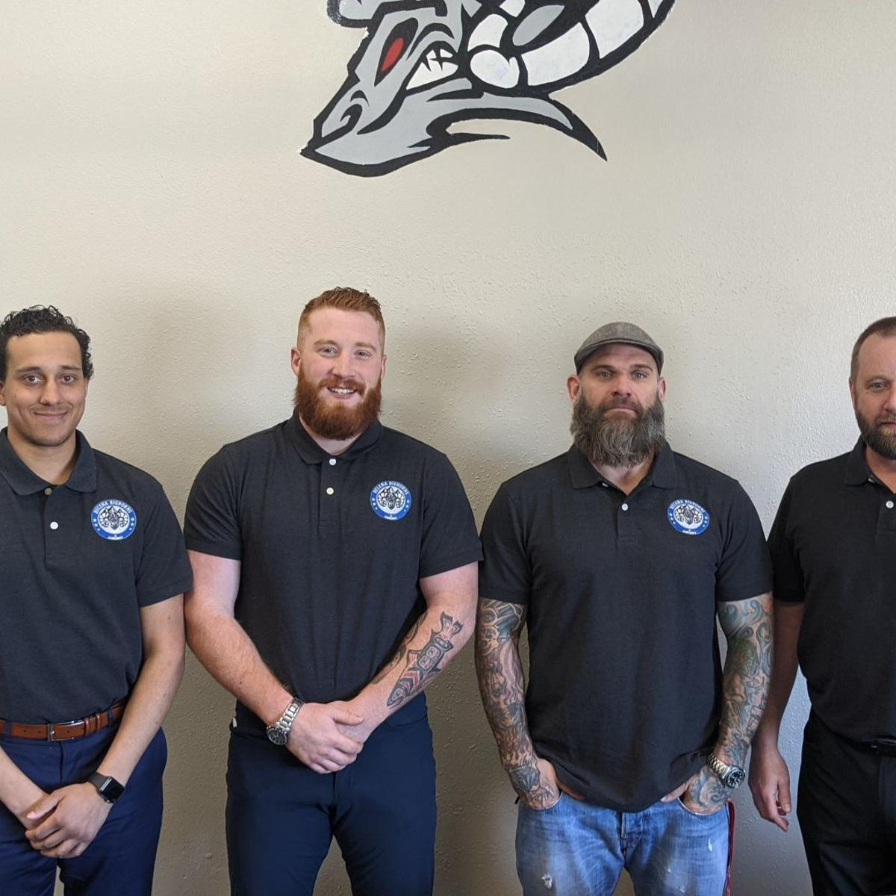
Jed Snyder (Owner)
Wants to minimize operating costs to keep ticket prices low
Wants to continue doing building improvements
Does not need help with a ticketing solution
Notes:
Kayla
when talking to Jed we found that he is looking to minimize the operating costs to not raise the price of the tickets of the fans. With a reduced cost in operations he has plans to improve the building in ways that the public would enjoy. He was thinking about updating the bar and upstairs viewing booths.
He is currently happy with his ticket system using vivenu and does not need a new ticketing system at this time

Slide 10
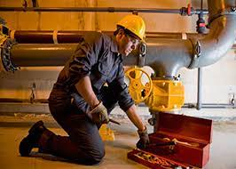
Mike (HVAC Master)
"While I'm committed to the upkeep, it's evident that addressing one issue often leads to another"
Notes:
(kayla) The implementation of improved systems would not only streamline operations but also provide peace of mind, ensuring a more stable and reliable environment for the day to day operations.

Slide 11
Project Purpose and Scope
Here we will perform high-level analysis of several solutions
Saving money by minimizing operations cost
Hard time accessing grants for project
Notes:
(clay)
Project purpose is to test methods on reducing energy costs and consumption.
Finding alternatives and testing the math for cost versus return on investment to enlighten the business on a potential financially sound method to cut down on the power bill is the objective. The owner has expressed how he doesn’t want to affect the cost to the public and without charging more for tickets the owner needs to find alternatives to reducing costs.
The owner would like to secure a grant with NWE, however, because Steed Arena is a for-profit business and NWE only provides grants for non-profit organizations this is not feasible.

Slide 12
Current description of System
Ticketing system
Ticketing system is managed through Vivenu
Owner expressed satisfaction with current ticketing process
Compressor System
Over 30 years old
Lack Variable Frequency Drives (VFDs)
High power consumption resulting in high monthly bills
Frequent breakdowns and maintenance issues
Energy Efficiency Consideration
No current solar power implementation
Owner has researched solar options
Climate Control Challenges
Difficulty in maintain internal atmosphere
Issues during summer, potential internal rain, leading to additional correction time.
Notes:
(kayla)
As clay meantionedd, the ticketing system, managed through Vivenu, functions well enough for Steed arena. In Steed Arena's current landscape, they're grappling with aging compressors, over 30 years old, consuming a significant amount of power.
Monthly bills fluctuate between $8,000 and $13,000 a month, and maintenance feels like a perpetual challenge—fix one thing, and another issue arises.
The building's internal atmosphere battles difficulties, especially in the summer, where the potential for rain-induced condensation demands extra time for correction.
While the idea of embracing solar power for sustainability is on the horizon, the feasability is still to be discovered and will be discussed later on.
our focus today is on optimizing the energy-intensive machinery for long-term efficiency.

Slide 13
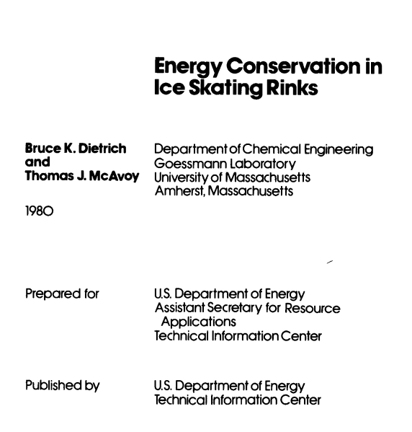
Similar Business Research
When doing similar business research, we came across this system analysis. Even with being published in 1980, it still gave valuable insight on what was considered when trying to reduce energy costs.
https://www.osti.gov/servlets/purl/5070122
Notes:
(kayla) In our pursuit of operational efficiency at Steed Arena, we found a remarkable systems analysis published in 1980 that provided insights into reducing energy costs. Despite its age, this analysis delves into a spectrum of methods and considerations,
from the installation of false ceilings to the strategic shutdown of systems during non-operational hours. It also explores heat and water transfer strategies, offering ideas that could still be relevant today. This resource was a light, inspiring our team to innovate based on proven principles while tailoring some of solutions to the unique challenges faced by Steed Arena.

Slide 14
Proposed Alternatives

Slide 15
Solar
Going solar could alleviate the NWE bill
Energy bought back is only NWE credits, not cash
NWE doesn’t want to help a for-profit business, alternative of CPASE
Notes:
oliver

Slide 16
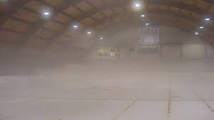



Humidity
Currently there is no humidity control in the arena
Munters
Desert Aire
Climate by Design International
Notes:
There are no pricing options listed, all estimates are provided through consultation.
Although there will be upfront costs of implementing a humidification system, this can be justified by the long-term savings achieved through improved energy efficiency, ice quality, equipment longevity, and operational efficiency. It's an investment that pays off over time by reducing ongoing operational and maintenance expenses.
Munters: Munters offers industrial dehumidification solutions, utilizing desiccant rotor technology to control humidity effectively in various applications. Munters' industrial desiccant dehumidifiers boast flexibility, modular design, and efficiency, delivering benefits such as high moisture removal rates, constant duty cycle operation, durability, and consistent performance.
Desert Aire: Their innovative, automatic hot gas “defrost-on-demand” technology ensures proper performance of their systems at the low temperatures required by ice rinks.
Climate by Design International: Uses desiccant dehumidifiers. A properly sized desiccant system is the most cost-effective way to condition an ice arena to eliminate fog and condensation because it is the only reasonable way to get very low humidity air. Depending on fuel pricing and availability, it can also yield significant energy savings for the rink.
Dessicant rotor technology: In contrast to traditional refrigeration-based dehumidification, where air is cooled to condense and remove moisture, desiccant rotor technology allows for dehumidification without significant changes in temperature. This is especially useful in applications where maintaining a specific temperature is critical.

Slide 17
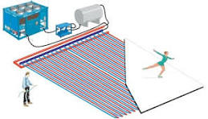


Compressors
Challenges with older compressors to install VFDs due to compatibility issues.
Newer compressor systems are designed with latest technologies.
Varied costs for a new compressor system. Upfront investment balanced by long-term energy cost savings
Hard to find pricing to do a cost analysis
Reputable Manufactures​
Bitzer: Globally recognized
​
Danfoss: Well-Established manufacturer
Notes:
(kayla) When we told that the compressors are a huge energy draw we looked into what would it would take to improve that system.
There is a challenge with the current older compressors to install VFDs due to compatibility issues. Variable frequency Drivers work by adjusting the frequency of the power supplied to the motor, VFDs can precisely control the speed of the compressor. This allows for modulation of the compressor output based on the actual demand, leading to energy savings and better control of the system.
Even so, newer compressor systems are designed with latest technologies but we ran into the fact there is Varied costs for a new compressor systems and getting a quote would be quite challenging as outsiders, so being unable to do an accurate cost analysis posed an challenge as well. Without an accurate quote for the upfront investment on a new compressors and the potential of being a huge chunk of money to being balanced by long-term energy cost savings might NOT be the most beneficial alternative, though, it might be cheaper than going solar, but without a energy audit today its hard to make a exact statement on this.
We did look into a couple companies that are reputable manufactures specializing in ice rinks.
Bitzer : a globally recognized company along many ice rinks. Its compressors are celebrated for their rapid freezing capability
Danfoss : well established manufacturer offering eco friendly solutions, being the first to install a efficient co2 system at a ice rink in beijing with their bock model compressors.

Slide 18
Recommended Alternative: Solar Panels
Going solar could save up to $12k / year
ROE of up to 14.5%
Relies on current compressors not breaking
Notes:
This is at:
6% interest rate
15% efficient panels

Slide 19
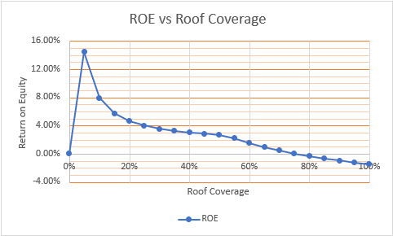
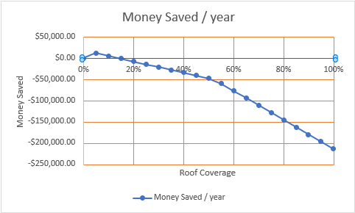
Notes:
Note about 6% interest rate cutoff on ROE vs Roof Coverage

Slide 20
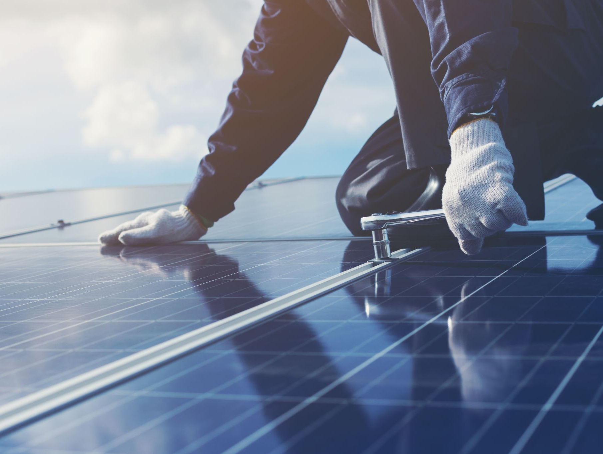
Benefits of System
Solar is good press
Reducing costs
Keeps costs offloaded to customer down.
Allows for more improvements on the building.
Notes:
Note about pushing ads (at 80% capacity rn)
6% = $15 raise / ticket since Jed bought in 2018

Slide 21
Cost Estimate of Proposed System
To secure the 14.5% ROE, cost would be only ~$150k, this would cover 5% of the roof with solar, saving $12k / year​
Steed arena is for profit – can't take advantage of NWE grants
Using the assumption that it would cost $375k for a new compressor system that would last 20 years.​
Notes:
Assuming compressors don't need to be replaced -> this money is "savings" in ROE

Slide 22
Conclusion
Ticketing System is hypothetical
Humidity could be addressed
Solar and VFDs are viable alternatives
Thank you, Jed for your valuable time and information to make this project possible.
Thank you, We hope we were able to shed some light on the various processes and issues involved in running an ice rink.
Notes:
For anyone joining this presentation partway through, we want to emphasize that our recommendations for a ticketing system are purely hypothetical. These findings all took place prior to our first meeting with the owner when we learned a new ticketing system was not needed.
but we hope we were able to shed some light on the various processes and issues involved in running an ice rink.

Slide 23
https://www.osti.gov/servlets/purl/5070122
https://www.northwesternenergy.com/docs/default-source/default-document-library/billing-and-payment/rates-and-tariffs/montana/rules/electric/rule_16_et.pdf
https://406mtsports.com/hockey/new-ownership-has-big-plans-for-helena-bighorns-hockey-team/article_3d416fee-d4f1-50bc-b9f7-61b92344b71e.html
https://www.yesenergysolutions.co.uk/advice/how-much-energy-solar-panels-produce-home
https://www.northwesternenergy.com/docs/default-source/default-document-library/clean-energy/environmental-projects/private-generation/level-2-3-and-4-small-generator-interconnection-request.pdf
https://www.northwesternenergy.com/docs/default-source/default-document-library/clean-energy/environmental-projects/private-generation/the-montana-consumer-guide-to-grid-interactive-solar-pv-systems.pdf
https://arena-guide.com/go-green/control-humidity-levels/
https://www.desert-aire.com/applications/ice-rink-dehumidifier
https://www.cdihvac.com/ice-arenas
https://www.munters.com/en/industries/recreation-and-leisure/ice-rinks/
https://www.yapsody.com/wp-content/uploads/2019/05/Must-Have-Features.png
https://www.brushfire.com/
https://osem.io/
https://www.eventbrite.com/
https://th.bing.com/th/id/R.78c3e98314b9c1a255bb20265af4b9b3?rik=CSH9%2b6Tz9KV1rg&riu=http%3a%2f%2fpluspng.com%2fimg-png%2fsystem-requirements-png-system-requirements-418.png&ehk=ya2Aq2YiEbOrXLXpOAecHHm7TGAg3ktdkS9PHF2AWfI%3d&risl=&pid=ImgRaw&r=0&sres=1&sresct=1

